Slide 1
Software… and the people who create it
Simon Hettrick
Deputy Director
ORCID: 0000-0002-6809-5195

Slide 2
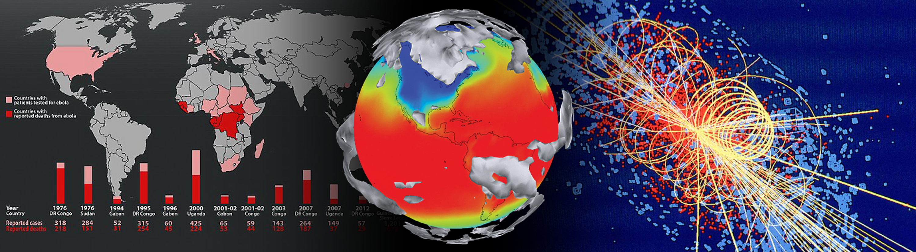
World-leading research relies on software
“Today there are very few science areas left which do not rely on IT and thus software for the majority of their research work. More importantly key scientific advances in experimental and observational science would have been impossible without better software.”
Kersten Kleese van Dam
Pacific Northwestern National Laboratory via change.org campaign
“Scientific discovery and innovation are advancing along fundamentally new pathways opened by development of increasingly sophisticated software. Software is an integral enabler of computation, experiment and theory, and directly responsible for increased scientific productivity and enhancement of researchers' capabilities.”
Dan Katz
SI² Program Director, National Science Foundation

Slide 3

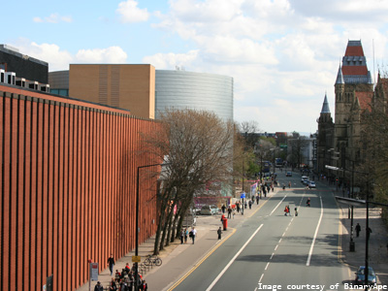
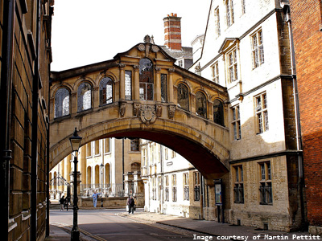
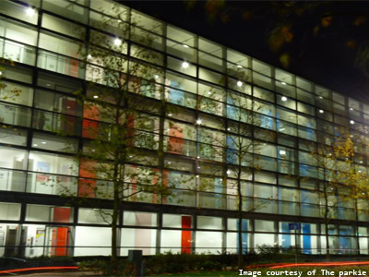

Software Sustainability Institute
Edinburgh
Manchester
Oxford
Southampton
www.software.ac.uk

Slide 4
Software
Policy
Training
Community

Slide 5
How important is software?

Slide 6
Research software
noun \rɪˈsəːtʃ ˈsɒf(t)wɛː\
Software that is used to generate, process or analyse results that you intend to appear in a publication.
Research software can be anything from a few lines of code written by yourself, to a professionally developed software package.
Software that does not generate, process or analyse results - such as word processing software, or the use of a web search - does not count as ‘research software’.

Slide 7
92%
of researchers use
research software
69%
say research would be
impossible without
research software
173,000
researchers in the UK
£1.9 billion
in 2015/16 financial year

Slide 8
31,000
reasons to be worried
56%
develop their own software
21%
no formal software development training

Slide 9
What software
is being used?

Slide 10
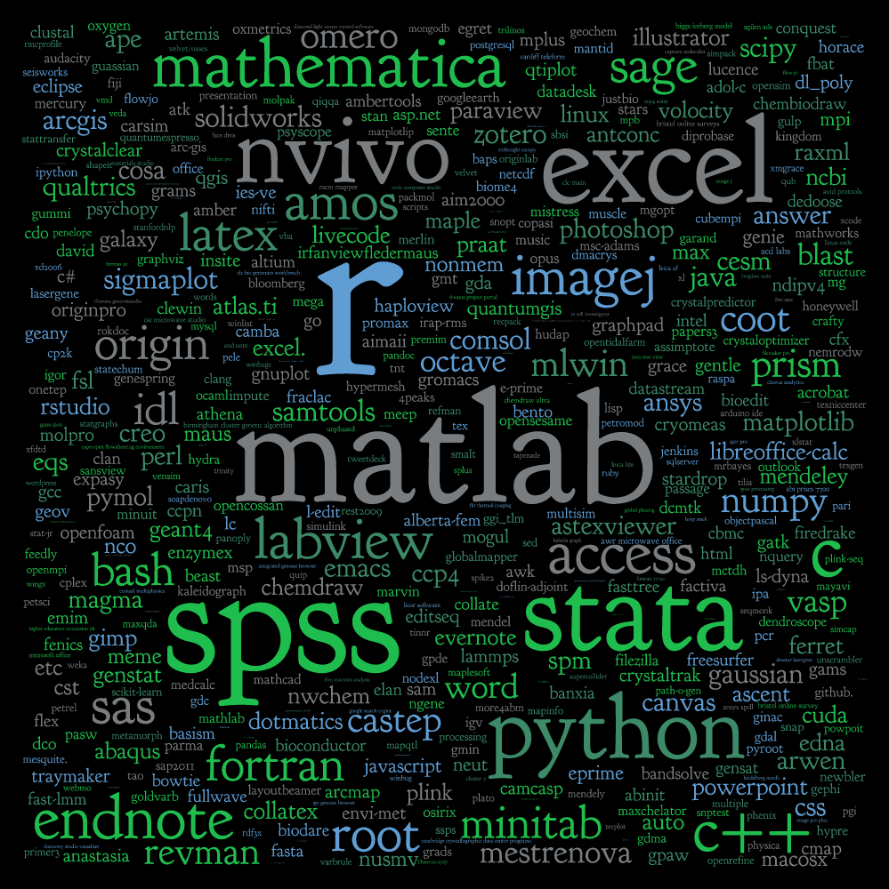
file:///.file/id=6571367.51409934

Slide 11
Who’s doing the work?

Slide 12
That person who knows a lot about research but mainly does software development because that’s the bit of research they seem to prefer

Slide 13
Analyst Developer
Analyst Programmer
Analyst Programmer - SITS (x 3)
Analyst/Programmer
Applications Developer
Applied Scientist
Architectural Robotics Developer
Assistant Data Programmer
Assistant Project Manager
Atmospheric Correction and Radiative Transfer Model Scientist
Audio Software Developer - KTP Associate
Bioinformatician
Bioinformatician In Potato Genomics and Genetics
Bioinformatician/Computational Bioscientist in Microbiology
Bioinformaticians
Bioinformatics Analyst
Bioinformatics Postdoctoral Researcher
Bioinformatics scientist
Biometric Software Systems Developer
Biorespository Software Developer
C++ / 3D Graphics Software Engineer
Casebooks Project Editor (Research Assistant/Associate)
Climate Researcher (Research Associate)
Clinical Study Programmer
CoMPLEX Research Associate
Computational Biologist / Bioinformatician
Computational Scientist
Computational Scientist in Computational Fluid Dynamics & Industrial Applications
Computational Scientist in Structural Mechanics and Industrial Applications
Computer Scientist
Computer Vision Researcher
Content Developer/Programmer
Control Engineer-IMG - 3 posts
CREATe Data Specialist
Data Analyst
Data Integration Coordinator
Data Manager x3
Database and Software Engineer
Database Manager/Researcher
Database Programmer
Digital Media Technician
E-Learning Portal Manager (KTP Associate)
e-Learning Systems Development Analyst
e-Learning Systems Development Analyst (Moodle, SQL)
E-Learning Web Developer
E-Portfolio Learning Technologist
Embedded Systems Engineer
Engineering Technician
Environmental Scientist
EPSRC Studentship on Algorithmic Construction of Finsler-Lyapunov Functions
Experimental Officer in Bioinformatics
Experimental Psychologist
Finance Assistant
Gaia Alerts Software Developer
Gaia Software Developer (Gaia UK Team)
GIS Applications Specialist
Graduate Programmer / Software Developer
Graphics Programmer
Health Data Manager / Scientist
High Throughput Bioinformatician
High Throughput Sequencing Bioinformatician (Two posts)
HIVE Manager/ HIVE Co-ordinator
HIVE Senior Researcher and Technical Lead
Hydro-informatics Scientific Software Developer
Image Analysis Manager for Cancer Imaging
Information Systems Developer
Instrumentation Engineer
Investigator Statistician
IT Developer
IT Services Manager
IT Services Specialist (e-Learning Systems)
IT Support Technician (Unix / Windows Systems)
Knowledge Transfer Partnership (KTP) Associate: Innovent Technologies LTD
Knowledge Transfer Partnerships (KTP) Associate - Software Developer
KTP Associate - Robot Vision Scientist (Research Fellow)
KTP Associate (Fixed Term Contract for 24 months)
KTP Associate (Precision Agriculture Data Analyst)
KTP Associate â€“ Graduate Web Developer
KTP Associate: Electronics / Robotics Engineer
Learning Technologist
Leicester Respiratory BRU IT Developer
Linguist / Psycholinguist
Maker Space Technician
Marie Curie Early Stage Researcher
Marie Curie Early Stage Researcher in Radar Rainfall for Integrated Water Quality Modelling
Marine Earth Observation Scientists
Medical Statistician
Medical Statistician/Senior Medical Statistician
Metrology Engineer
Mobile Application Developer
NASC IT Support - Programmer and Systems Administrator (Fixed-term)
NIHR Research Methods Fellow
PDRA on EU Project on Automated Multisensor Surveillance
Planning Officer
Policy Modeller 2014
Post - Doctoral Research Assistant â€“ INSTRON
Post Doctoral Research Worker
Post Doctoral Researcher in the application of Digital Technology
Post-Doctoral Research Assistant in Simulation and Visualization
Post-Doctoral Research Associate
Post-Doctoral Research Associate (Pathogen Genomics)
Post-Doctoral Research Fellow
Postdoctoral Fellow - population genetics / evolutionary genetic
Postdoctoral Fellow in Bioinformatics
Postdoctoral Fellow in Cancer Therapeutics
Postdoctoral Research Assistant
Postdoctoral Research Associate
Postdoctoral Research Fellow
Postdoctoral Research Scientist
Postdoctoral Researcher in Declarative (Logic and Functional) Programming
Postdoctoral Researcher
Postdoctoral Scientist
Postdoctoral statistician
Postdoctoral Training Fellow - Statistical and Computational Genetics of Autism
Principal / Senior Bioinformatician
Principal Bioinformatician
Product Development Engineer (Rail)
Publishing Portal Web Developer
Radio Frequency Engineer
Reader in Computer Science
Reporting Analyst
Research (Software) Engineer
Research Assistant
Research Associate
Research Fellow
Research Image Data Manager, Biomedical Engineering
Research Officer
Research Officer â€“ Social Protection
Research postgraduate
Research Programmer
Research Scientist
Research Scientist / Senior Research Scientist
Research Scientist in Machine Learning and Computer Vision
Research Software Developer
Research Software Developer for the Herchel Smith Professor of Organic Chemistry
Research Software Engineer
Research Studentship
Research Worker
Researcher
SAP Trainee Technical Analyst
Scientific Officer with Michela Garofalo
Scientist
SEAHA Studentship: Extracting epidemiological data from collections
SEEG Data Archive Manager
Senior / Research Associate in Clinical Integration and Image Analysis for Fetal Surgery
Senior Analyst Programmer (Business Analysis)
Senior Analyst/Programmer
Senior Bioinformatician
Senior Bioinformatician / Bioinformatician
Senior Computational Statistician - Spatial Models
Senior Data Acquisition Scientist / Data Acquisition Scientist
Senior Data Manager
Senior Database Administrator
Senior IT Developer Analyst
Senior Mathematical Modeller
Senior Media Developer
Senior Postdoctoral Researcher - Evolutionary and Computational Analysis of Infectious Disease (Phylodynamics)
Senior Research Assistant
Senior Research Associate
Senior Research Associate â€“ Molecular Modelling & Simmulation
Senior Research Associate in Quantitative Clinical MRI
Senior Research Fellow
Senior Research Fellow/Research Fellow in Vibration Diagnostics and Prognostics/Digital Signal Processing
Senior Research Laboratory Technician
Senior Research Technician
Senior Software Developer in Bioinformatics
Senior Software Engineer / Software Engineer
Senior Statistical Epidemiologist
Senior Systems Administrator
Senior Technician / Demonstrator (UCMK)
Senior Web Developer
SharePoint Developer
Software Developer
Software Developer (Bioinformatics)
Software Developer (KTP Associate)
Software Developer x 2
Software Developer/Programmer
Software Developers in e-Learning
Software Engineer
Software/ Database Developer (KTP Associate)
Sports Programme Manager
Statistical Geneticist
Statistical Programmer/Data Scientist
Statistician
Statistician/Epidemiologist
Student and Enrolment Services Manager
SWCAR Information Assistant
System Administrator
Systems Developer
Systems, Data and Applications Team Leader
Teaching Fellow in Computational
Analyst Developer
Analyst Programmer
Analyst Programmer - SITS (x 3)
Analyst/Programmer
Applications Developer
Applied Scientist
Architectural Robotics Developer
Assistant Data Programmer
Assistant Project Manager
Atmospheric Correction and Radiative Transfer Model Scientist
Audio Software Developer - KTP Associate
Bioinformatician
Bioinformatician In Potato Genomics and Genetics
Bioinformatician/Computational Bioscientist in Microbiology
Bioinformaticians
Bioinformatics Analyst
Bioinformatics Postdoctoral Researcher
Bioinformatics scientist
Biometric Software Systems Developer
Biorespository Software Developer
C++ / 3D Graphics Software Engineer
Casebooks Project Editor (Research Assistant/Associate)
Climate Researcher (Research Associate)
Clinical Study Programmer
CoMPLEX Research Associate
Computational Biologist / Bioinformatician
Computational Scientist
Computational Scientist in Computational Fluid Dynamics & Industrial Applications
Computational Scientist in Structural Mechanics and Industrial Applications
Computer Scientist
Computer Vision Researcher
Content Developer/Programmer
Control Engineer-IMG - 3 posts
CREATe Data Specialist
Data Analyst
Data Integration Coordinator
Data Manager x3
Database and Software Engineer
Database Manager/Researcher
Database Programmer
Digital Media Technician
E-Learning Portal Manager (KTP Associate)
e-Learning Systems Development Analyst
e-Learning Systems Development Analyst (Moodle, SQL)
E-Learning Web Developer
E-Portfolio Learning Technologist
Embedded Systems Engineer
Engineering Technician
Environmental Scientist
EPSRC Studentship on Algorithmic Construction of Finsler-Lyapunov Functions
Experimental Officer in Bioinformatics
Experimental Psychologist
Finance Assistant
Gaia Alerts Software Developer
Gaia Software Developer (Gaia UK Team)
GIS Applications Specialist
Graduate Programmer / Software Developer
Graphics Programmer
Health Data Manager / Scientist
High Throughput Bioinformatician
High Throughput Sequencing Bioinformatician (Two posts)
HIVE Manager/ HIVE Co-ordinator
HIVE Senior Researcher and Technical Lead
Hydro-informatics Scientific Software Developer
Image Analysis Manager for Cancer Imaging
Information Systems Developer
Instrumentation Engineer
Investigator Statistician
IT Developer
IT Services Manager
IT Services Specialist (e-Learning Systems)
IT Support Technician (Unix / Windows Systems)
Knowledge Transfer Partnership (KTP) Associate: Innovent Technologies LTD
Knowledge Transfer Partnerships (KTP) Associate - Software Developer
KTP Associate - Robot Vision Scientist (Research Fellow)
KTP Associate (Fixed Term Contract for 24 months)
KTP Associate (Precision Agriculture Data Analyst)
KTP Associate â€“ Graduate Web Developer
KTP Associate: Electronics / Robotics Engineer
Learning Technologist
Leicester Respiratory BRU IT Developer
Linguist / Psycholinguist
Maker Space Technician
Marie Curie Early Stage Researcher
Marie Curie Early Stage Researcher in Radar Rainfall for Integrated Water Quality Modelling
Marine Earth Observation Scientists
Medical Statistician
Medical Statistician/Senior Medical Statistician
Metrology Engineer
Mobile Application Developer
NASC IT Support - Programmer and Systems Administrator (Fixed-term)
NIHR Research Methods Fellow
PDRA on EU Project on Automated Multisensor Surveillance
Planning Officer
Policy Modeller 2014
Post - Doctoral Research Assistant â€“ INSTRON
Post Doctoral Research Worker
Post Doctoral Researcher in the application of Digital Technology
Post-Doctoral Research Assistant in Simulation and Visualization
Post-Doctoral Research Associate
Post-Doctoral Research Associate (Pathogen Genomics)
Post-Doctoral Research Fellow
Postdoctoral Fellow - population genetics / evolutionary genetic
Postdoctoral Fellow in Bioinformatics
Postdoctoral Fellow in Cancer Therapeutics
Postdoctoral Research Assistant
Postdoctoral Research Associate
Postdoctoral Research Fellow
Postdoctoral Research Scientist
Postdoctoral Researcher in Declarative (Logic and Functional) Programming
Postdoctoral Researcher
Postdoctoral Scientist
Postdoctoral statistician
Postdoctoral Training Fellow - Statistical and Computational Genetics of Autism
Principal / Senior Bioinformatician
Principal Bioinformatician
Product Development Engineer (Rail)
Publishing Portal Web Developer
Radio Frequency Engineer
Reader in Computer Science
Reporting Analyst
Research (Software) Engineer
Research Assistant
Research Associate
Research Fellow
Research Image Data Manager, Biomedical Engineering
Research Officer
Research Officer â€“ Social Protection
Research postgraduate
Research Programmer
Research Scientist
Research Scientist / Senior Research Scientist
Research Scientist in Machine Learning and Computer Vision
Research Software Developer
Research Software Developer for the Herchel Smith Professor of Organic Chemistry
Research Software Engineer
Research Studentship
Research Worker
Researcher
SAP Trainee Technical Analyst
Scientific Officer with Michela Garofalo
Scientist
SEAHA Studentship: Extracting epidemiological data from collections
SEEG Data Archive Manager
Senior / Research Associate in Clinical Integration and Image Analysis for Fetal Surgery
Senior Analyst Programmer (Business Analysis)
Senior Analyst/Programmer
Senior Bioinformatician
Senior Bioinformatician / Bioinformatician
Senior Computational Statistician - Spatial Models
Senior Data Acquisition Scientist / Data Acquisition Scientist
Senior Data Manager
Senior Database Administrator
Senior IT Developer Analyst
Senior Mathematical Modeller
Senior Media Developer
Senior Postdoctoral Researcher - Evolutionary and Computational Analysis of Infectious Disease (Phylodynamics)
Senior Research Assistant
Senior Research Associate
Senior Research Associate â€“ Molecular Modelling & Simmulation
Senior Research Associate in Quantitative Clinical MRI
Senior Research Fellow
Senior Research Fellow/Research Fellow in Vibration Diagnostics and Prognostics/Digital Signal Processing
Senior Research Laboratory Technician
Senior Research Technician
Senior Software Developer in Bioinformatics
Senior Software Engineer / Software Engineer
Senior Statistical Epidemiologist
Senior Systems Administrator
Senior Technician / Demonstrator (UCMK)
Senior Web Developer
SharePoint Developer
Software Developer
Software Developer (Bioinformatics)
Software Developer (KTP Associate)
Software Developer x 2
Software Developer/Programmer
Software Developers in e-Learning
Software Engineer
Software/ Database Developer (KTP Associate)
Sports Programme Manager
Statistical Geneticist
Statistical Programmer/Data Scientist
Statistician
Statistician/Epidemiologist
Student and Enrolment Services Manager
SWCAR Information Assistant
System Administrator
Systems Developer
Systems, Data and Applications Team Leader
Teaching Fellow in Computational Methods
UTRCI Research Scientist, Control Systems
Web Application Programmer
Web Developer

Slide 14


Slide 15
Research
Software
Engineer
www.rse.ac.uk

Slide 16
The craftsperson and the scholar
http://www.software.ac.uk/blog/2012-11-09-craftsperson-and-scholar
Ten reasons to be an RSE
http://www.software.ac.uk/blog/2013-08-23-ten-reasons-be-research-software-engineer
Engineering a future for research software and its makers
http://www.researchresearch.com/index.php?option=com_news&template=rr_2col&view=article&articleId=1345478
Save your work – give software engineers a career track
https://www.timeshighereducation.co.uk/news/save-your-work-give-software-engineers-a-career-track/2006431.article

Slide 17
UK Association of Research Software Engineers
417 members, www.rse.ac.uk
Research Software Groups
Culham, DIAMOND, Imperial, Kings, Manchester, Sheffield, Southampton, UCL
Buy in from Research Councils
Career paths on their way…

Slide 18
www.software.ac.uk
@SoftwareSaved
s.hettrick@software.ac.uk

